Slide 1

DIABETES PRIDICTION MODEL
PRIDICTION MODEL

Slide 2

DIABETES PRIDICTION MODEL
Group Members:
Aamir Ali (DS-016)
Muhammad Talal Hussain (CCEE)
Muhammad Zeeshan (DS-027)

Slide 3
Project Overview:
Objective
Our project aims to leverage supervised machine learning techniques to predict the likelihood of diabetes based on relevant health indicators.
Significance
Diabetes is a widespread health concern globally, and early prediction plays a crucial role in preventive healthcare. Traditional diagnostic methods can be time-consuming and may lack the precision that machine learning models can provide. By applying machine learning algorithms to a diabetes dataset, we seek to enhance the accuracy and efficiency of prediction, contributing to early intervention and better patient outcomes.

Slide 4
Supervised Machine Learning:
Supervised learning is a type of machine learning where algorithms learn to make predictions based on labeled training data. It can be used for regression (predicting continuous values) and classification (assigning inputs to predefined categories). Popular algorithms include linear regression, decision trees, and neural networks. Supervised learning automates decision-making processes, impacting fields like finance, healthcare, and image recognition.

Slide 5
Model Used on Dataset:
KNearesrt Neighbor Algorithm
Naïve Bayes Algorithm
Decision Tree Algorithm
Random Forest Algorithm

Slide 6
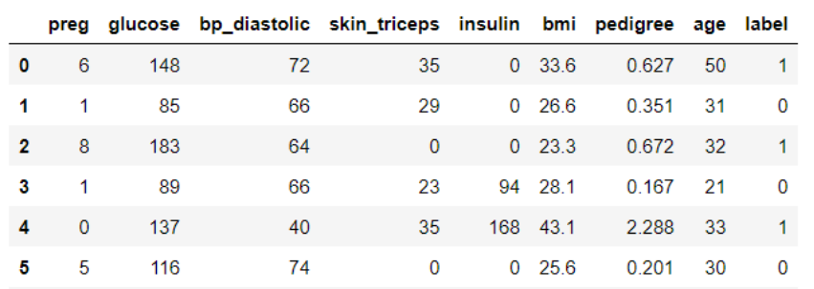
Dataset
Diabetes Dataset CSV File:
Discover the key insights hidden in the Diabetes dataset. With 1536 instances and independent features like ['preg', 'glucose', 'bp_diastolic', 'skin_triceps', 'insulin', 'bmi', 'pedigree', 'age‘], this dataset holds valuable information for analysis. The target variable ['label‘] provides a focus for predicting and understanding diabetes.

Slide 7
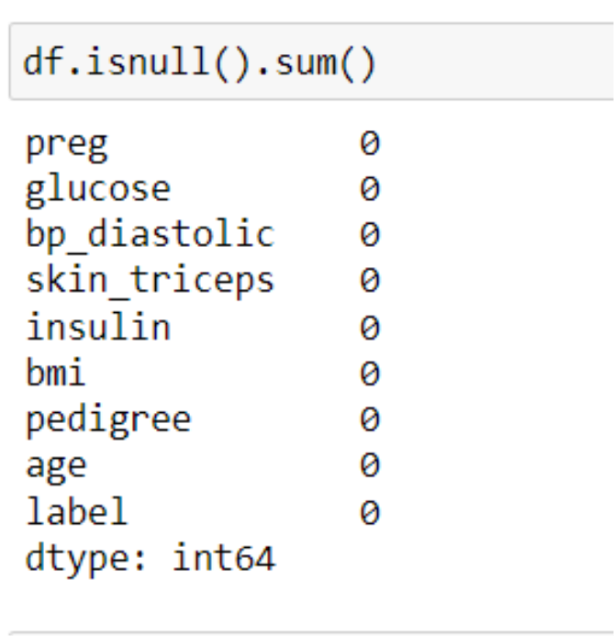
Data Pre-Processing:
1)Handling missing values:
Didn’t Find any missing values or Inconsistencies in the dataset.

Slide 8
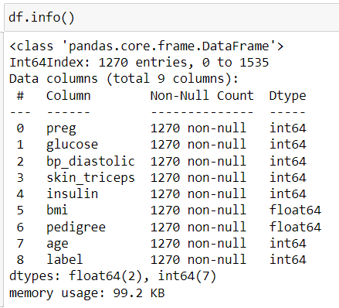
2) Data Formatting:
The dataset is already in a favorable format, so there is no need to reformate it.

Slide 9
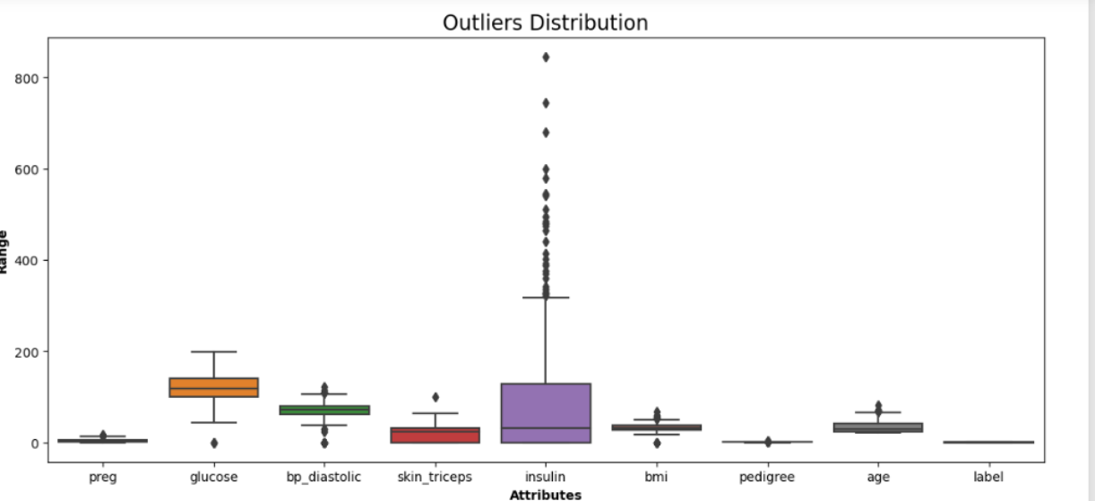
Finding Outliers:
Boxplot graph was used for outlier detection. All features contained outliers which could potentially affect the end result. Therefore, they were removed in the next step.

Slide 10
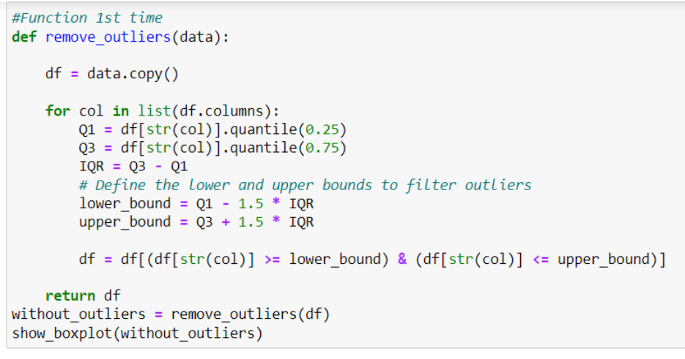
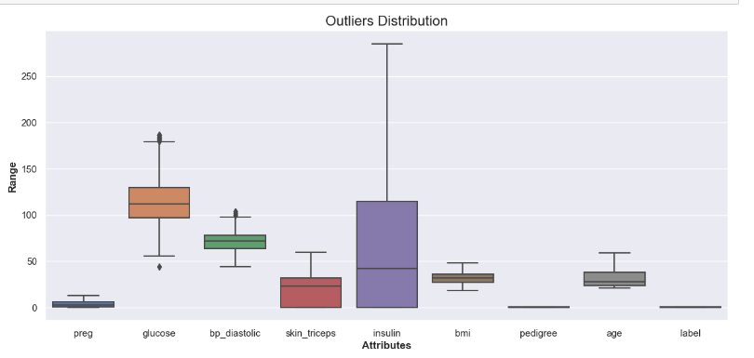
Handling Outliers:
Using the Quantile Method, outliers were removed by running the function thrice.

Slide 11
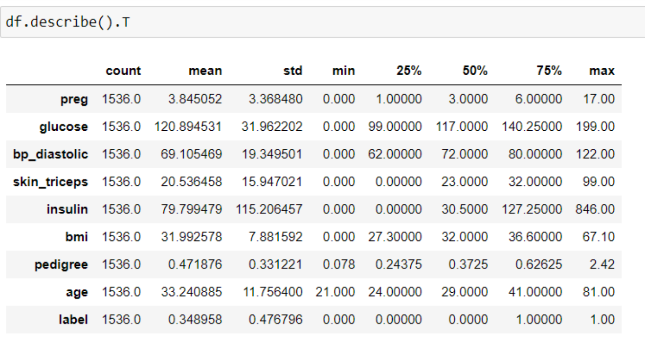
Exploratory Data Analysis (EDA)
1)Descriptive Statistics:

Slide 12
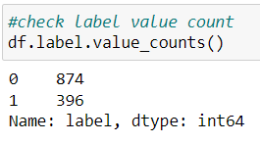
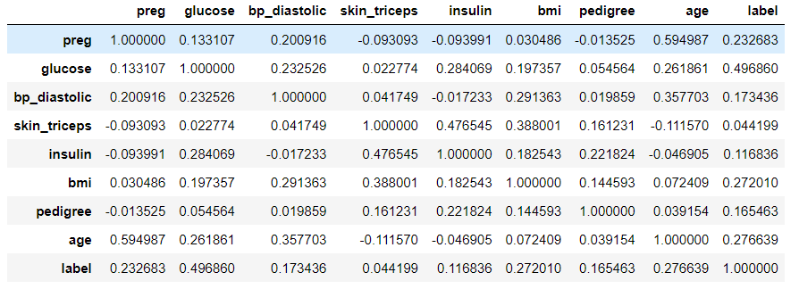
Label count:
Correlation:

Slide 13
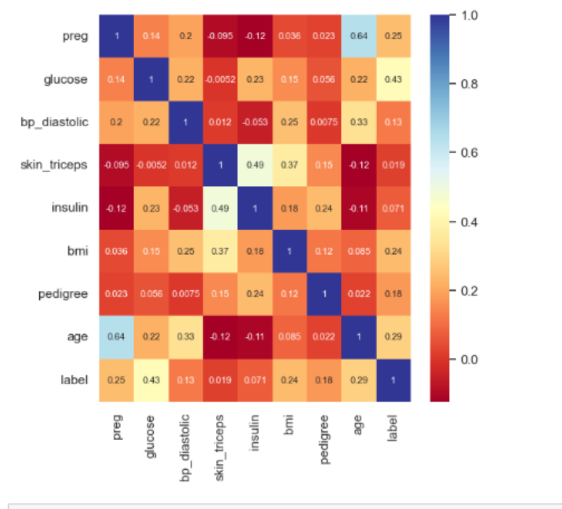
2)Graphical Analysis:
Heat Map
Heat Map displays the correlation between dependent and independent features in a graphical form, making analysis easier.

Slide 14
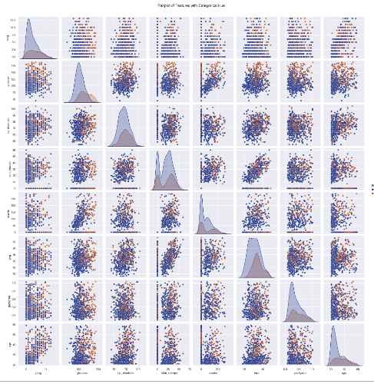
Pair Graph:
A pair plot provides a grid of scatterplots to visualize relationships and histograms for individual variable distributions, aiding in the exploration of patterns and correlations in multivariate datasets.

Slide 15
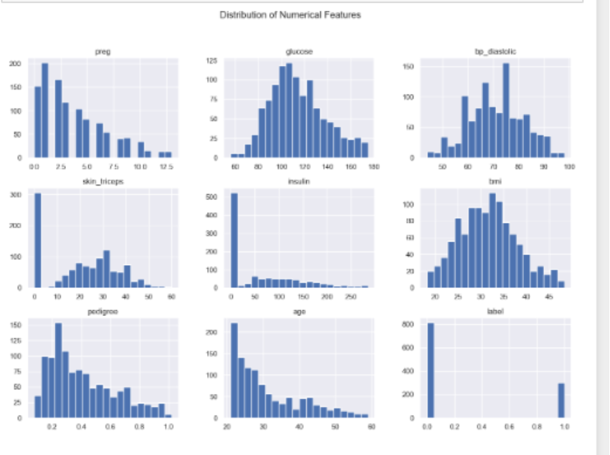
Distribution of Variables:

Slide 16
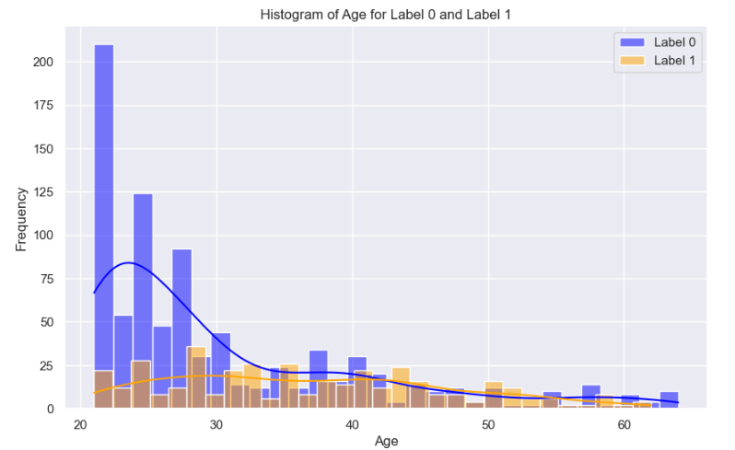
Age vs Label

Slide 17
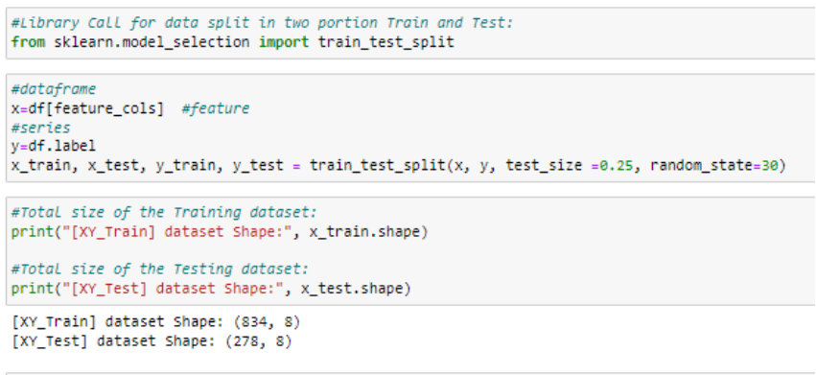
Model Evolution
1)Data Train Test Split:
Training Size=75%
Test Size =25%
Random State =30%

Slide 18
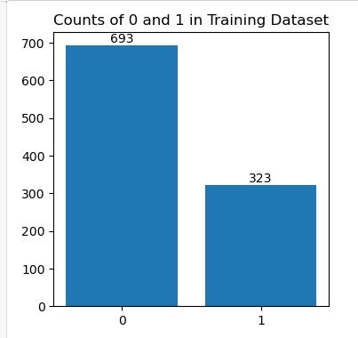
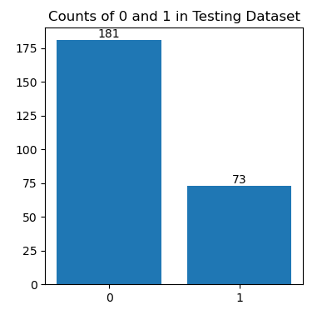
Data Distribution:
The dataset is initially split into two portions: training and test. The value count for both sets is determined.

Slide 19
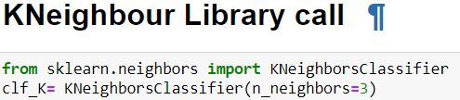
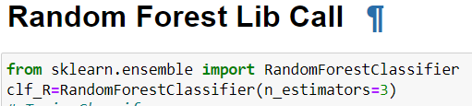
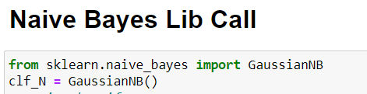
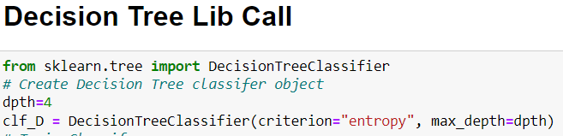
2) Libraries for Model:

Slide 20
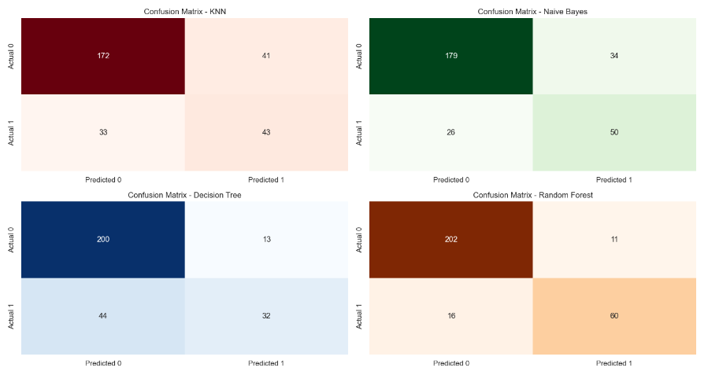
Model Evaluation
3)Confusion Matrix Of Model:

Slide 21
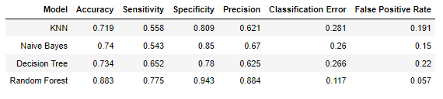
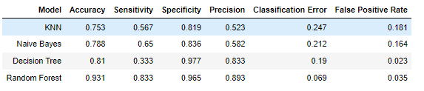
Model Performance Before Improvement:
Model Performance After Improvement:

Slide 22
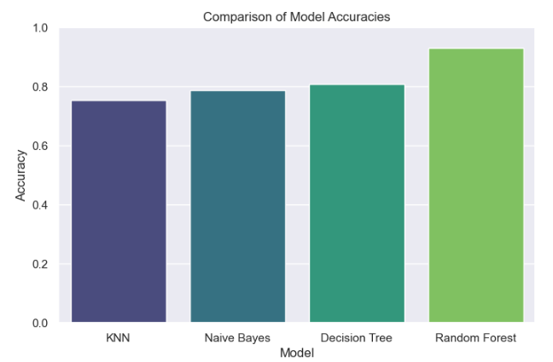
Accuracies Graph Comparison:

Slide 23
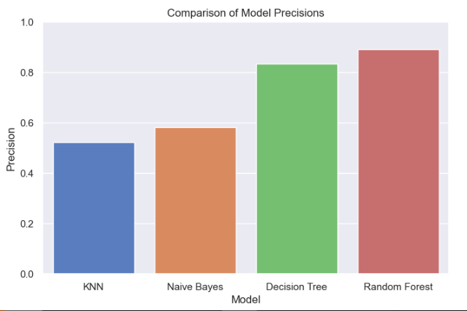
Precision Graph Comparison:

Slide 24
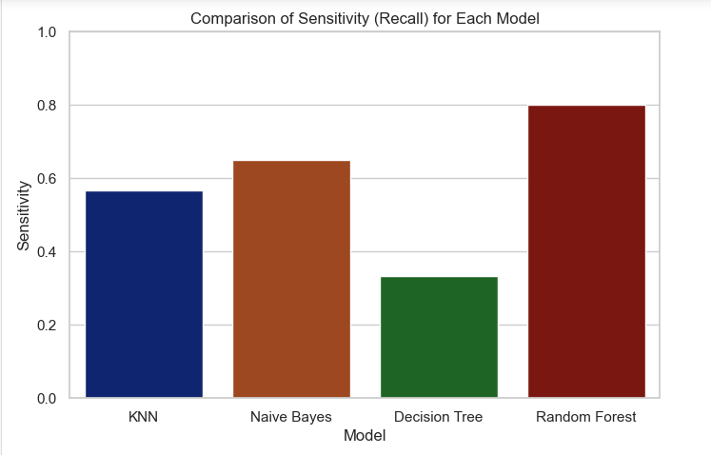
Sensitivity/Recall Graph Comparison:

Slide 25
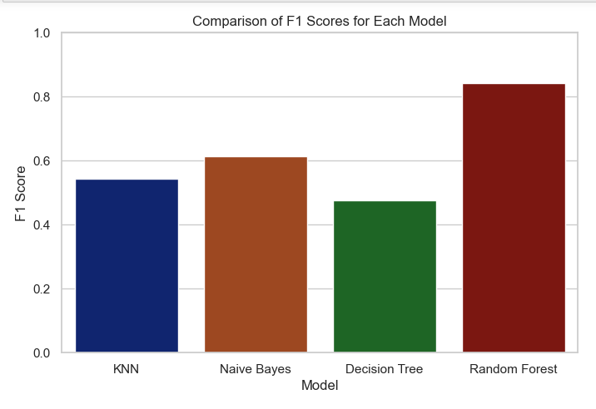
F1-Score Comparison:

Slide 26
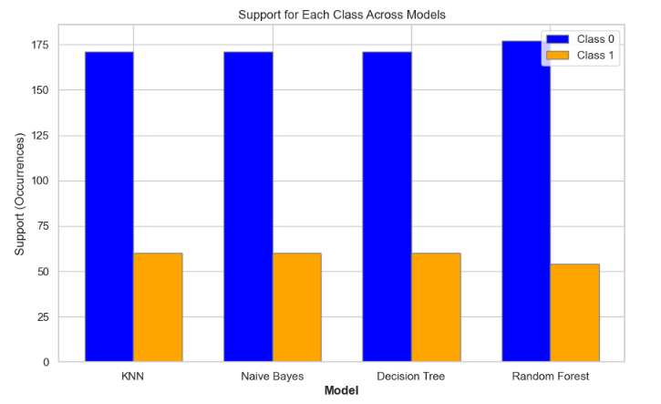
Support Comparision:

Slide 27
Opinon:
Random Forest outperforms other models with the highest accuracy (93.1%) and balanced performance across sensitivity, specificity, and precision.
Decision Tree shows high specificity (97.7%) but lower sensitivity (33.3%), indicating potential overfitting.
Naive Bayes demonstrates a balanced performance with good accuracy (78.8%) and sensitivity (65.0%).
KNN exhibits moderate performance, with a focus needed on improving sensitivity and precision.

Slide 28
Conclusion:
In summary, Random Forest stands out as the top-performing model, achieving superior accuracy (93.1%) and a well-balanced trade-off between sensitivity, specificity, and precision. Decision Tree, while excelling in specificity, shows signs of potential overfitting with lower sensitivity. Naive Bayes presents a balanced alternative, and KNN exhibits moderate performance with opportunities for improvement in sensitivity and precision. Model selection should align with specific objectives, recognizing Random Forest as a robust choice, while considering nuances and potential optimizations for each model.

Slide 29
Thank You

